Slide 1
Evaluating Taekwondo Moves
System to recognize and evaluate video of performed taekwondo moves
Srilakshmi Medarametla

Slide 2
Background
Vital to reassure correct and adjust incorrect technique
Current action recognition → Microsoft Kinect
Built off Bagalkot & Wang (‘20) ’s “Creating a Classifier for Dance and Martial Arts Moves” with CMU’s OpenPose instead of Kinect
Notes:
To give you a little background, as a taekwondo athlete, I know it is vital that athletes have an appropriate reassurance of good technique and correction of bad technique for a specific skill or move in order to prevent injury or muscle strain since they typically cannot observe and judge themselves
Current action recognition projects in the field typically use technology such as motion-capture, or Microsoft Kinects sensors which return video input with 3D coordinates of the user’s joints.
However, expanding on the foundational work developed by Neha Bagalkot and Sophia Wang (TJHSST ‘20) in the Computer Systems Lab last year, I plan to create a system to recognize and evaluate taekwondo moves with the more accessible phone camera using Carnegie Mellon University’s OpenPose library return 2D coordinates from a single camera view.

Slide 3
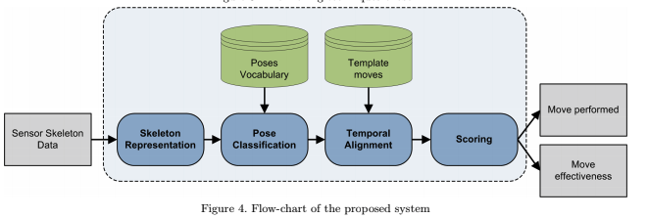
Phases
“Karate Moves Recognition from Skeletal Motion” Bianco & Tisato, 2013
Notes:
This project is largely based off Bianco & Tisato’s 2013 article “Karate Moves Recognition from Skeletal Motion” which outlines the following 4 main modules
The skeleton representation module is needed to transform the raw videos into a meaningful representation of the relative location of a user’s joints.
The pose classification module classifies each skeleton representation into one of previously defined poses.
The temporal alignment module aligns the sequence of vocabulary poses and the template poses in the time domain.
The scoring module computes the similarity between two aligned sequences; it can be used both to recognize which move has been performed and to evaluate the effectiveness of the move itself.

Slide 4
Skeleton Representation: VideoPose3D
Insert videos here
Notes:
In the past few months, I’ve made major progress in implementing the Skeleton Representation module
I’ve asked my taekwondo instructor, pictured in this video, to take about 25 videos for the left-hand and right-hand side of 2 punches, 3 kicks, and 5 blocks. In addition to the side view pictured here, he’s also taken front views, all which compose the about 900 videos that make up my dataset. At this point, just because it provides the most standardized way to see all the joints from one viewpoint, I’m leaning towards using only the side views.
Once I run this video through the OpenPose software I have running on a Google Colab file, I can create the video pictured to the right, with the joints superimposed. I’ve written generalized data processing to run this procedure automatically. OpenPose also gives me the coordinates of joints, frame by frame, which I then convert into an angles representation. For now, there’s about 13 angles between joints that I’ve chosen to include in my system, for example, the angle at a user’s elbow, but it’s possible that I may include more in the future to refine the model
One drawback of using OpenPose through Google Colab is that I can’t create an integrated offline GUI where the user can choose a video file on their local machine and have OpenPose render the superimposed video in real time since Google Colab doesn’t support GUIs.

Slide 5
Pose Classification: Vocabulary Poses with K-means
How many poses (clusters) per move?
How to represent a move as a sequence of poses?
Notes:
Cluster angles by pose with K-means to make up the bank of vocabulary poses

Slide 6
Pose Classification: KNN
How many poses (clusters) per move?
How to represent a move as a sequence of poses?
Notes:
Cluster angles by pose with K-means to make up the bank of vocabulary poses

Slide 7
Temporal Alignment & Scoring
Get ideals
Notes:
Use DTW to align the series appropriately.
For example, say the blue is a sequence of poses for a given move, say a front kick, of the exemplar/master and the red is the same for a user. The user may perform the more quickly than the exemplar, but that doesn’t mean that their technique is incorrect which it would if we scored the sequence with Euclidean matching. With DTW, we match the highs with the highs and the lows with the lows to more accurately evaluate how closely the user’s performance matches the master’s. This similarity score is the basis for the scoring, which is the end of the system.
I hope to implement these last two modules within the next two months, and get back to you all with the results.

Slide 8
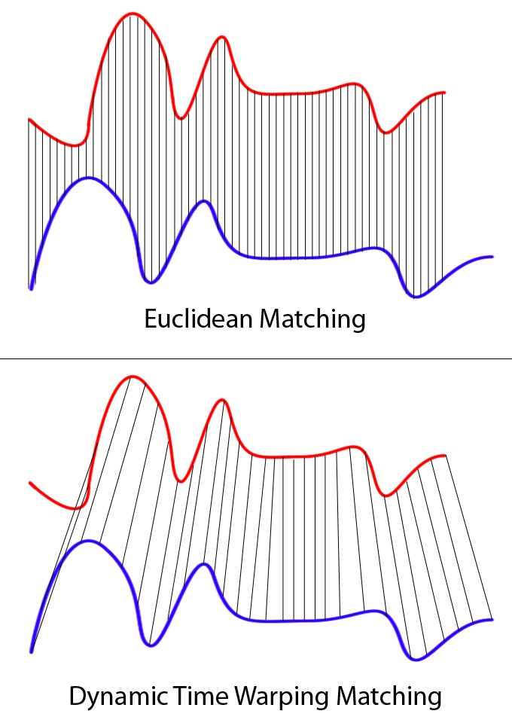
Temporal Alignment & Scoring
Notes:
Use DTW to align the series appropriately.
For example, say the blue is a sequence of poses for a given move, say a front kick, of the exemplar/master and the red is the same for a user. The user may perform the more quickly than the exemplar, but that doesn’t mean that their technique is incorrect which it would if we scored the sequence with Euclidean matching. With DTW, we match the highs with the highs and the lows with the lows to more accurately evaluate how closely the user’s performance matches the master’s. This similarity score is the basis for the scoring, which is the end of the system.
I hope to implement these last two modules within the next two months, and get back to you all with the results.

Slide 9
Temporal Alignment & Scoring
Notes:
Use DTW to align the series appropriately.
For example, say the blue is a sequence of poses for a given move, say a front kick, of the exemplar/master and the red is the same for a user. The user may perform the more quickly than the exemplar, but that doesn’t mean that their technique is incorrect which it would if we scored the sequence with Euclidean matching. With DTW, we match the highs with the highs and the lows with the lows to more accurately evaluate how closely the user’s performance matches the master’s. This similarity score is the basis for the scoring, which is the end of the system.
I hope to implement these last two modules within the next two months, and get back to you all with the results.

Slide 10
Discussion
Possible next steps, what could be improved
Notes:
Use DTW to align the series appropriately.
For example, say the blue is a sequence of poses for a given move, say a front kick, of the exemplar/master and the red is the same for a user. The user may perform the more quickly than the exemplar, but that doesn’t mean that their technique is incorrect which it would if we scored the sequence with Euclidean matching. With DTW, we match the highs with the highs and the lows with the lows to more accurately evaluate how closely the user’s performance matches the master’s. This similarity score is the basis for the scoring, which is the end of the system.
I hope to implement these last two modules within the next two months, and get back to you all with the results.

